Slide 1



SWHIZZ TECHNOLOGIES

Slide 2


SOFTWARE TESTING
What is Software Testing?
Why Software Testing is Necessary?
How to Justify the Software Quality
Different Aproaches of Software Testing
Levels of testing

Slide 3


Verification
Are we Developed Right Product/Software OR not
Done by Developers
Software Testing
Validation
Developed product/Software is Right or Not
Done by Testers

Slide 4


WHY SOFTWARE TESTING IS NECESSORY?
Reliability
Faults
To Learn The Reliability of the Software /Product
Software is likely to have faults
To avoid Failure
Quality
Business
Because Failures are very Expensive
To deploy the quality Software to the Client
To avoid the complaints from the client and to stay in business with good reputation

Slide 5
SOFTWARE QUALITY
Software should be bugs/defects free
Software should be User Friendly
Software should be with in the budget and deliver with in the time
software should meet all the customer requiremnts&Expectaions
Software should be under customer maintenance

Slide 6
Manual Testing Approach
test cases are executed manually without using any automated tool. All test cases executed by the tester manually according to the end user's perspective.
How we can Find the Quality of the Software
Automation Testing Approach
which is used some specific tools to execute the test scripts without any human interference.

Slide 7



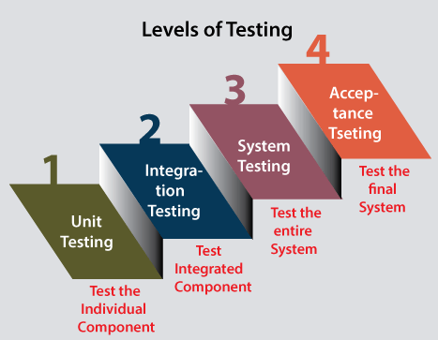

LEVELS OF SOFTWARE TESTING
Software will be Tested in Different levels to make sure that the Software is working fine

Slide 8


UNIT TESTING
Isolate the each Component in the software to make sure that each componet in the software is working according to the requirements

Slide 9
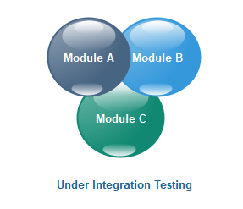
INTEGRATION TESTING
Integrate two or more Components to make sure that they function correctly and working according to the requirements

Slide 10
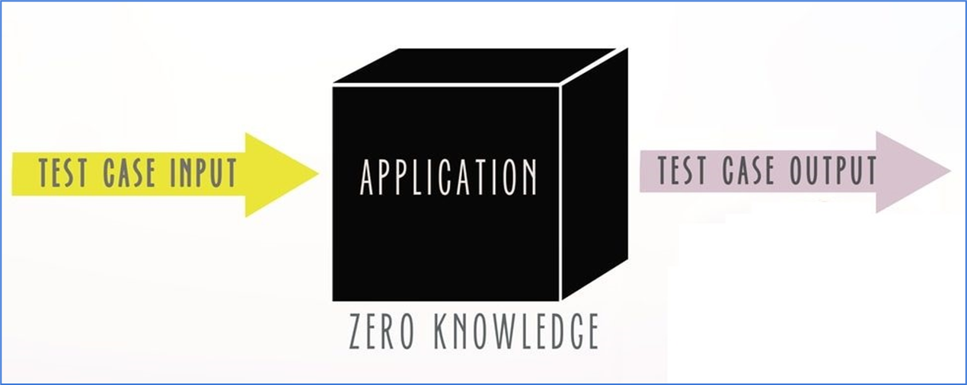
Black Box Testing/System Testing

Slide 11
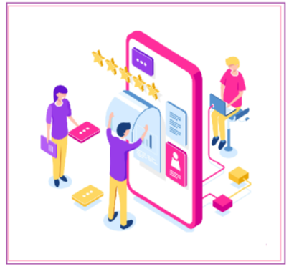
User Acceptance testing
Alpha testing
Test Environment(Testers)
Beta Testing
Client Environment(Client’s team)

Slide 12

Project we Deal in the Course
1.Retail Management Project
2.Admin Portal
3.Ecommerce Domain

Slide 13

Contents and Duration of theCourse

Slide 14
Why Swhizz?
Following the project-oriented training By working on user stories
Real time people will deliver the classes
Hands on experience.
One to One monitoring
Interaction sessions
Doubts Clarification Session
Expertise in resume preparation
Mock interviews
Job assistance
Associated with 50+ Clients
900+ students got placed

Slide 15




THANK YOU
OFFICE
venkoti building,#502,plot:809,60,Jai Hind Gandhi Rd,near YSR Statue,Madhapur,Telangana,500081
09392002299
www.swhizz.com
We look forward to working with you

